Slide 1
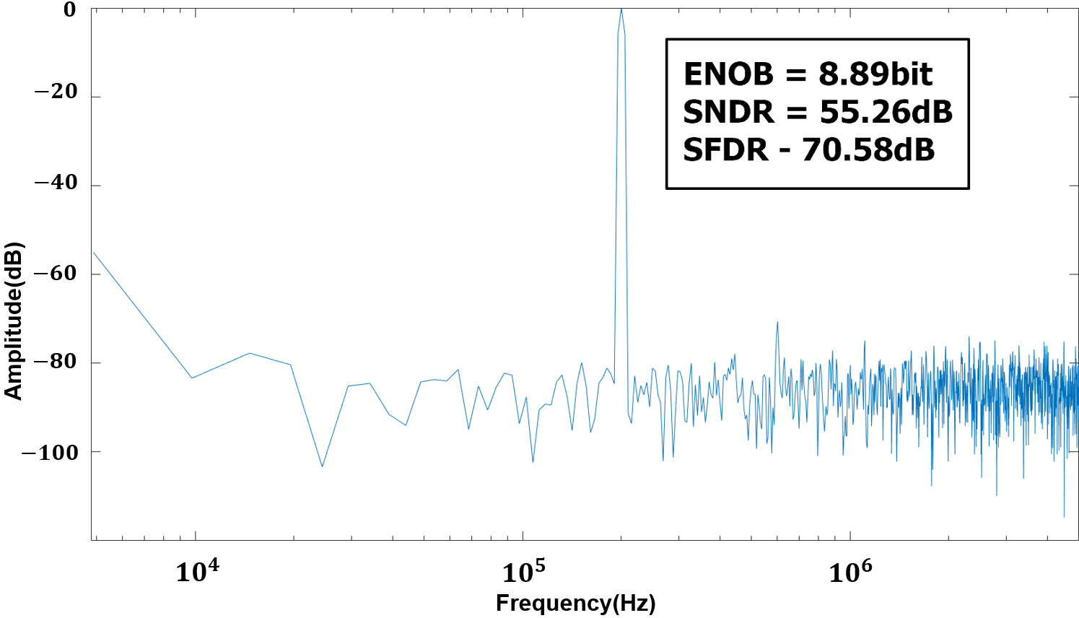
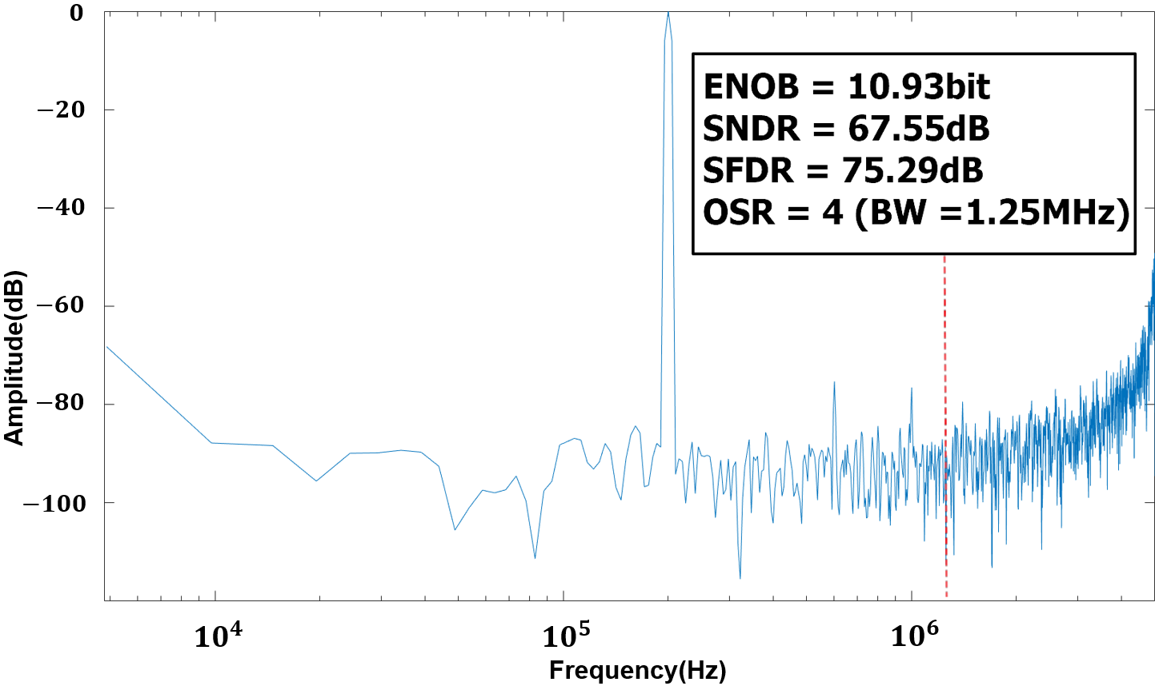
Simple and Energy Efficient Noise-Shaping SAR ADC
Yegeun Kim¹, Kyeongwon Jeong¹, Gichan Yun¹ and Minkyu Je¹
¹School of Electrical Engineering, KAIST
Introduction
This paper presents energy-efficient simple noise-shaping successive approximation register(SAR) ADC. Merged capacitor switching based SAR ADC is used to save ADC power consumption and apply simple noise-shaping(NS) technique.
Architecture
To save ADC power consumption, merged capacitor switching(MCS) based SAR ADC is used. Also, cascaded integrator feed forward(CIFF) structure is used for noise-shaping which is widely used in NS SAR ADCs. For simple noise-shaping, just store residue voltage of last bit decision and apply to multi-input comparator.
Block diagram of simple noise-shaping(NS) SAR ADC
Post layout simulation result and Conclusion
This paper presents a MCS based SAR ADC with simple NS technique. Simple noise shaping technique based on CIFF structure is applied to achieve higher SNDR and energy efficiency.
Architecture | NS SAR
Technology(nm) | 65nm
Bandwidth(MHz) | 1.25MHz
Sampling rate(MHz) | 10
Power(uW) | 71.26
ENOB(bits) | 10.93
SNDR(dB) | 67.55
ADC FFT results with/without noise-shaping NSSAR Post-sim result table
References
[1] J. Fredenburg and M. Flynn, "A 90MS/s 11MHz bandwidth 62dB SNDR noise-shaping SAR ADC," 2012 IEEE International Solid-State Circuits Conference, 2012, pp. 468-470.
[2] Hariprasath, V. & Guerber, J. & Lee, S.-H & Moon, U.-K. (2010). Merged capacitor switching based SAR ADC with highest switching energy-efficiency. Electronics Letters. 46. 620 - 621.
[3] You-Kuang Chang, Chao-Shiun Wang and Chorng-Kuang Wang, "A 8-bit 500-KS/s low power SAR ADC for bio-medical applications," 2007 IEEE Asian Solid-State Circuits Conference, 2007, pp. 228-231.
Acknowledgment
The chip fabrication was supported by the IDEC, Korea.

